Slide 1

Adventure Works Dashboard Report

Slide 2

By:
Esraa Ibrahim
Yasmin Ahmed
Marwa Tarek
Mervat Farag

Slide 3

Introduction
Purpose
The Adventure Works 2019 Analysis Dashboard provides insights into the fictional Adventure Works company's operations.
Company Overview
Adventure Works is a manufacturer and retailer of bicycles and related products. It operates in various regions, including North America, Europe, and Asia.

Slide 4

Data Source
The dashboard utilizes the Adventure Works 2019 sample database provided by Microsoft.
Scope
The dashboard includes data from various departments of the Adventure Works company, including Sales, customers production.

Slide 5
Metrics And KPIs
Sales Metrics
Customers Metrics
Products Metrics
Total Sales
Total COGS
Profit & Profit Margin
Total Freight
Total Tax
Sales by years and quarter
Sales by country region & Territory
Sales by category & product name
Number of customers
Number of stores
Number of orders
Number of order quantity
Number of customers by gender
Number of customers by marital status
Number of customers by education
Number of customers by age group
Top 5 customers (total sales)
Number of products
Order quantity by category
Order quantity by subcategory
Order quantity by year and quarter
Order quantity by territory
Order quantity by product

Slide 6

Definitions
Total Sales
Sum of all sales transactions within a specified period.
Sales by Region
Breakdown of sales figures by geographic regions.
Total COGS
Total cost of goods sold.

Slide 7




Dashboard Layout
Navigation
Visualizations
Filters
The dashboard is organized into several sections, each focusing on a specific business function.
Charts, tables, maps, and filters.
Dropdown menus and sliders for filtering data by date ranges, regions, or product categories.

Slide 8

Analysis And Insights
1
Trends and Patterns
Analyze annual trends and identify peak sales areas.
2
Production Insights
Identify the products with the top sales amount and number of orders each year.
3
Comparative Analysis
Compare sales figures in different years to identify growth patterns.

Slide 9
Key Performance Indicators:
1
Total sales: 123.22 M
5
Total tax: 10.19 M
9
No. of orders: 31 K
2
Total COGS: 100.47 M
6
Total freight: 3.18 M
10
Total of order quantity: 275 K
3
Profit: 22.74 M
7
No. of customers: 20 K
11
No. of products: 504
4
Profit margin: 18.46 %
No. of stores : 702
8

Slide 10
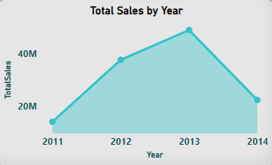
Insights:
In the year 2013, the company witnessed remarkable sales, reaching a total of 48,963,887.96. Following closely behind, the sales in 2012 amounted to 37,675,700.31. Conversely, the lowest sales were recorded in 2011. Through careful analysis, it was observed that the sales performance exhibited an upward trend, steadily improving as the years progressed until reaching 2014.

Slide 11
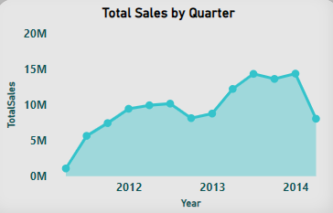
Insights:
Sales performance exhibited a significant decline in quarter 2 of 2011, followed by fluctuating sales and a decline in quarter 4 of 2012. However, sales in 2013 demonstrated consistent growth with minimal declines across the fourth quarter. In 2014, there were instances of declining sales observed in the second quarter.

Slide 12
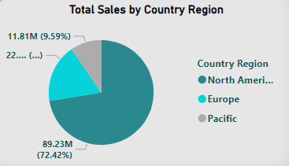
Insights:
Among the regions, North America recorded the highest sales, amounting to a total of 89,228,792.39. Europe followed with sales of 22,173,617.63, while the Pacific region generated a total sales of 11,814,376.10.

Slide 13
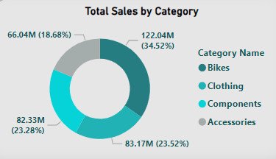
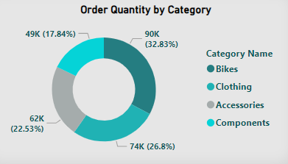
Insights:
Components emerged as the product category with the lowest number of orders, and the lowest sales. Conversely, bikes recorded the highest sales, indicating a significant contribution to sales. Notably, the order quantity for bikes is 90268, suggesting that customers tend to spend this amount on products within the bike category.

Slide 14
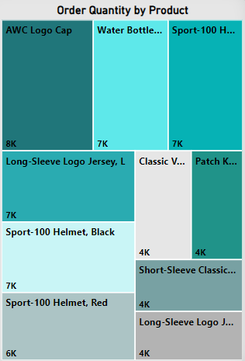
Insights:
The product “AWC Logo Cap” achieved the highest number of units sold, totaling 8311. Following closely behind is the “Water Bottle”, totaling 6815, and the “Sport 100 Helmet” in the blue color, totaling 6743.

Slide 15
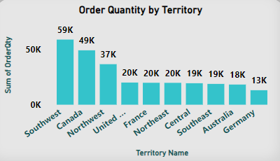
Insights:
The analysis showed that the southwest region of the US merged as the leader in sales, surpassing other regions, despite not having the highest number of orders. The region’s impressive sales revenue can be attributed to its large customer base, which has likely contributed to the overall success. In contrast, Australia had the highest number of orders but struggled in terms of sales. This can be attributed to the relatively low order quantity within the region. Despite a high volume of orders, the quantity per order was not sufficient to drive substantial sales.

Slide 16
Insights:
The most popular products across the regions varied, the AWC Logo caps ranked as the most ordered item among customers in seven regions. However, in specific regions such as the northwest, Australia, and Germany, the water bottle gained prominence as the most popular and frequently ordered product.

Slide 17
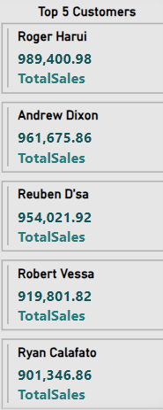
Insights:
Among the customers, Roger Harui, Andrew Dixon, Reuben D’sa, Robert Vessa, and Ryan Calafato displayed a strong purchasing power, having spent 4,726,247 across 61 orders (9287 order quantity).

Slide 18

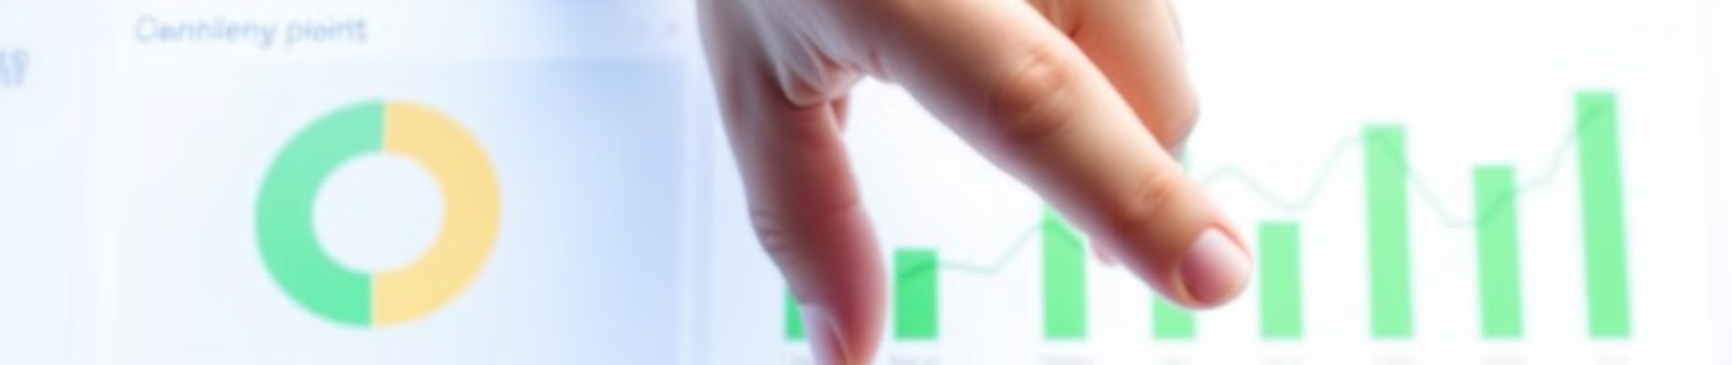



Interactive Elements
Date Filters
Drill-down
Export Data
Allows users to select specific time periods for analysis.
Click on summary metrics to explore detailed views.
Option to export filtered data or reports in various formats (e.g., Excel, PDF).

Slide 19

Technical Details
SQL
Power bi (Dax, Power query, Data modeling)
Glossary
COGS = order quantity * cost
Profit = Total sales – Total COGS
References
Documentation for SQL Server and Adventure Works 2019 database.

Slide 20

SQL

Slide 21
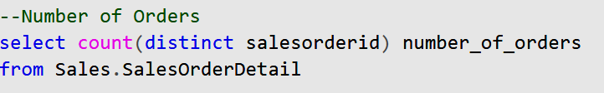
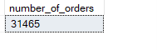
Key Metrics:
Number of Orders:
Total distinct sales orders

Slide 22
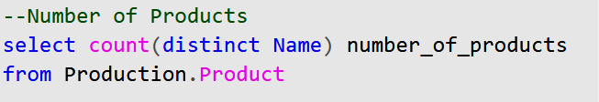
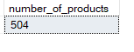
Key Metrics:
2. Number of Products:
Total distinct products available

Slide 23
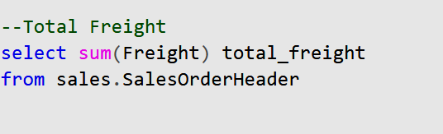
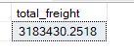
Key Metrics:
3. Total Freight Costs:
Overall freight costs incurred

Slide 24
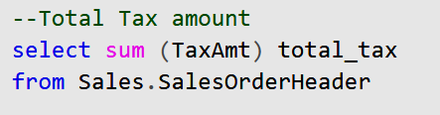
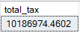
Key Metrics:
4. Total Tax Amount:
Tax amount collected

Slide 25
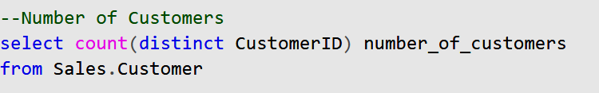
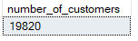
Key Metrics:
5. Number of Customers:
Total distinct customers

Slide 26
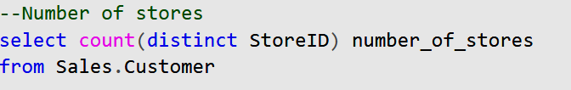
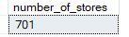
Key Metrics:
6. Number of stores:
Total distinct stores operating

Slide 27
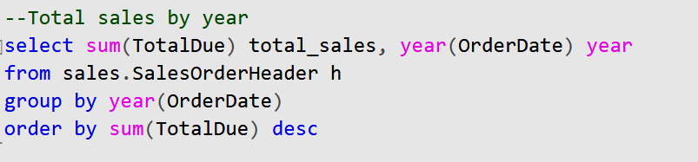
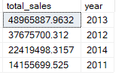
Sales Performance:
Total Sales by Year: The total sales was summarized by year, showing the trend of sales over time.

Slide 28
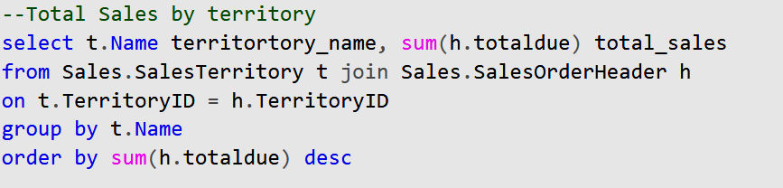
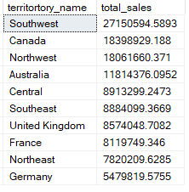
Sales Performance:
Total Sales by Territory: Sales performance across different territories

Slide 29
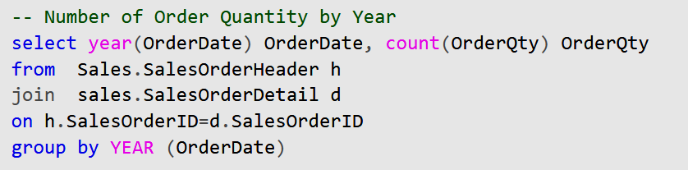
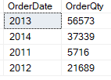
Sales Performance:
Number of Order Quantity by Year: Analysis of order quantities year-over-year indicates trends in customer purchasing behavior.

Slide 30
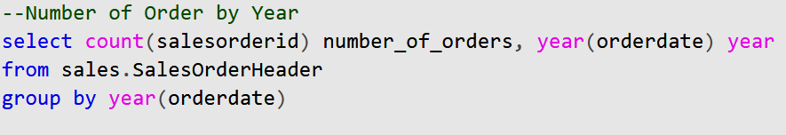
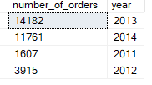
Sales Performance:
Number of Orders by Year: total number of sales orders placed each year helps to identify trends in customer purchasing behavior and seasonal patterns.

Slide 31
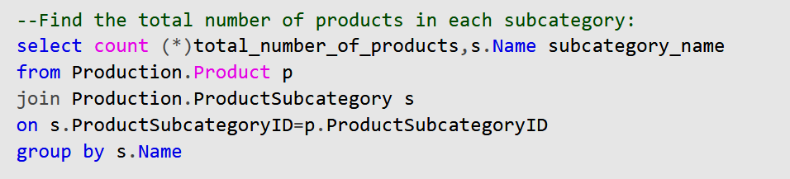
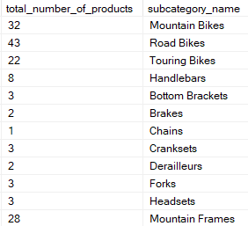
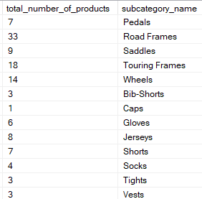
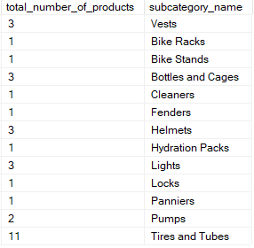
Product insights:
Total Products in Each Subcategory: Breakdown of total products available by subcategory:

Slide 32
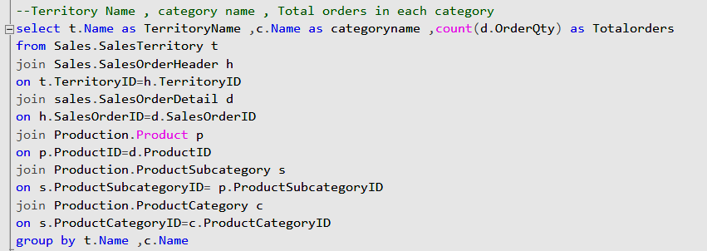
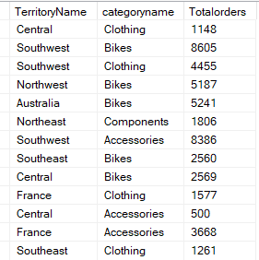
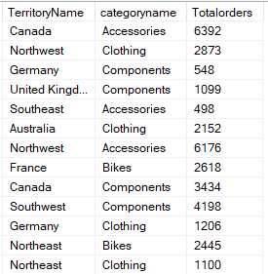
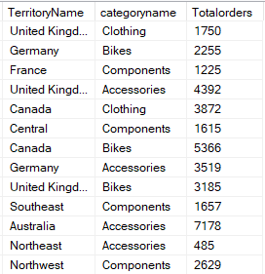
Product insights:
Total Orders in Each Category by Territory: Analysis of orders categorized by territory and product category

Slide 33
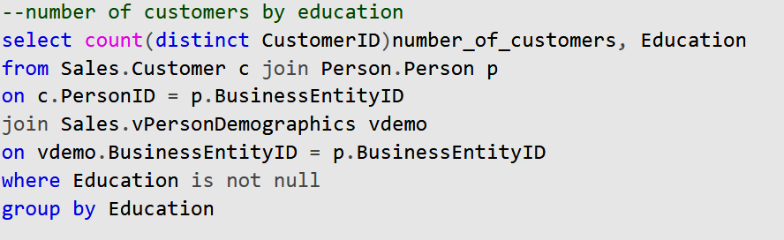
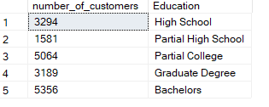
Customer Demographics:
Number of Customers by Education Level: Customer base segmented by education level

Slide 34
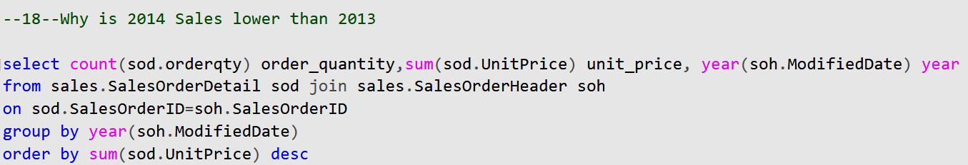
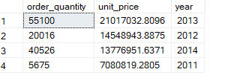
Yearly Comparison Analysis:
Sales Decline in 2014: Investigation into the reasons behind lower sales in 2014 compared to 2013 revealed a drop in order quantities and unit prices.

Slide 35

Python

Slide 36
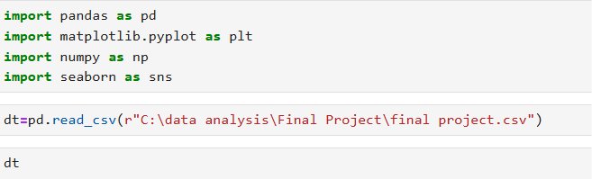
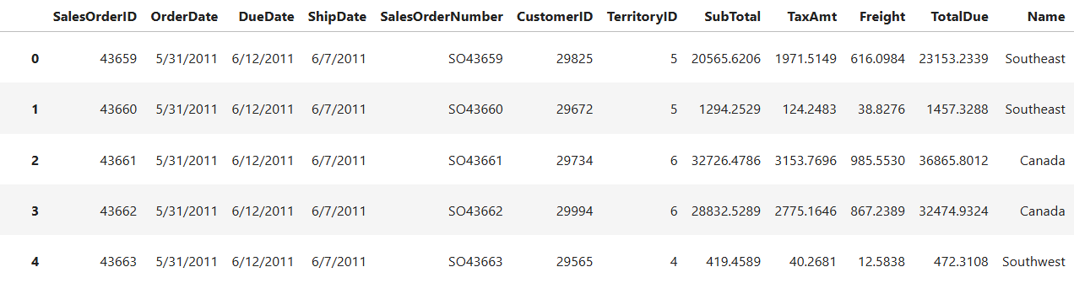
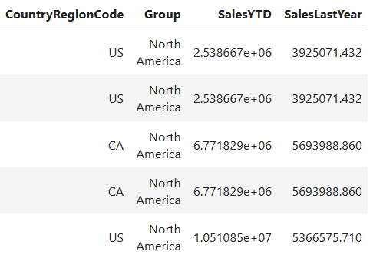
The dataset was imported using pd.read_csv(), pointing to the specified CSV file

Slide 37
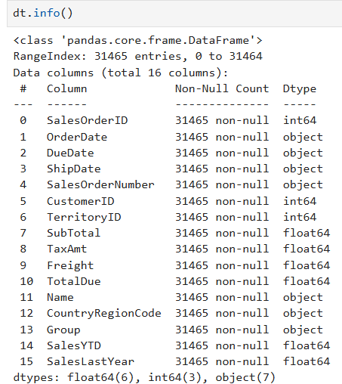
Initial exploration revealed essential information about the data structure through dt.info(), including data types and non-null counts.

Slide 38
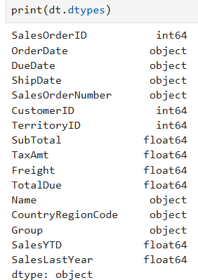
Data Types: The dataset contains various data types, primarily numerical and categorical.

Slide 39
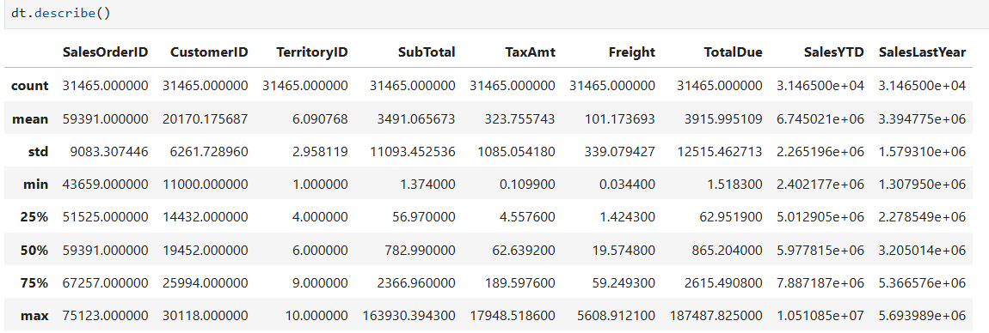
Summary Statistics: Using dt.describe(), basic statistics such as mean, median, and standard deviation for numerical columns were obtained.

Slide 40
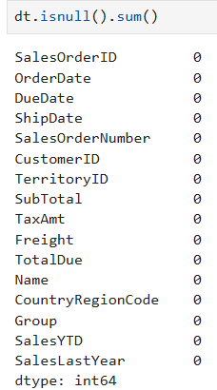
Missing Values: The analysis of null values with dt.isnull().sum() indicated any columns needing attention.

Slide 41
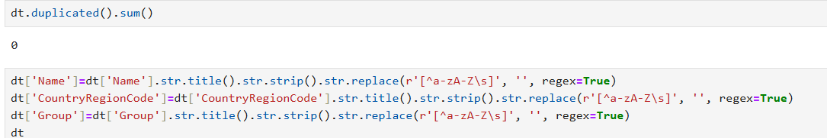
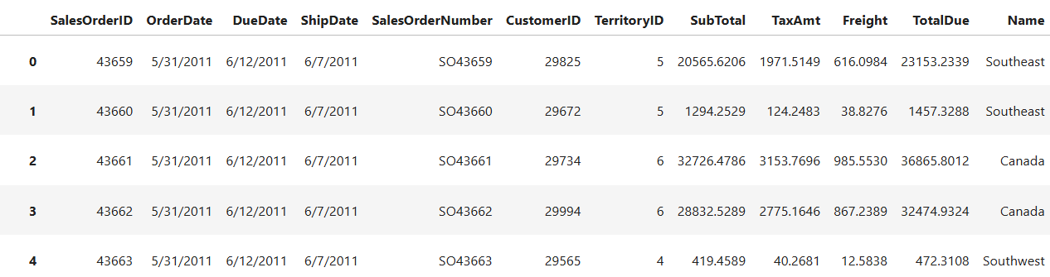

Duplicates: A check for duplicates with dt.duplicated().sum() confirmed the uniqueness of records.
Data Cleaning
Data cleaning involved:
Formatting string columns (Name, CountryRegionCode, Group) to title case, stripping whitespace, and removing special characters using .str.title().str.strip().str.replace().

Slide 42


Converting OrderDate and ShipDate to datetime format for further analysis.

Slide 43


Converting OrderDate to quarter for further analysis.

Slide 44


Calculating fulfillment time as the difference between day and shipday.

Slide 45


Aggregated total sales using groupby on Name, producing a bar chart to visualize total sales across different territories.

Slide 46


Analyzed yearly sales trends by grouping data by year and plotting total sales, indicating growth or decline trends over the years.

Slide 47


Identified the top 10 customers by total sales, visualized through a horizontal bar chart.

Slide 48



Visualized sales distribution by territory using a pie chart, showing the proportion of total sales per territory.

Slide 49


Sales were further analyzed on a quarterly basis, showing trends through line plots for a more granular view of sales performance.

Slide 50


Analyzed average fulfillment time per territory, displayed in a bar chart, highlighting efficiency across different regions.

Slide 51
Thanks

